Slide 2
ship your code, with Docker
Vincent Batts :: @vbatts

Slide 3








$> id vbatts

Slide 4
History
January 2013, work started on docker internally
March 2013, first public release
Statistics:
  10,974 stars on github
  390 contributors
  1760 forks

Slide 5
Problems
Installing software
Documentation
Configuration
Deterministic environment
Testing

Slide 6
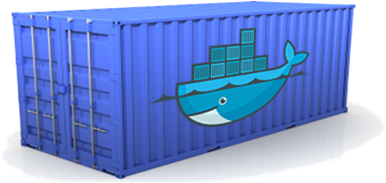
Docker Containers
Standardized Interface
Developer Concerns
Code
Libraries
Services
Configuration
Data
All Servers look the same
Operations Concerns
Logging
Monitoring
Process Management
Network Configuration
Storage
All Containers look the same

Slide 7
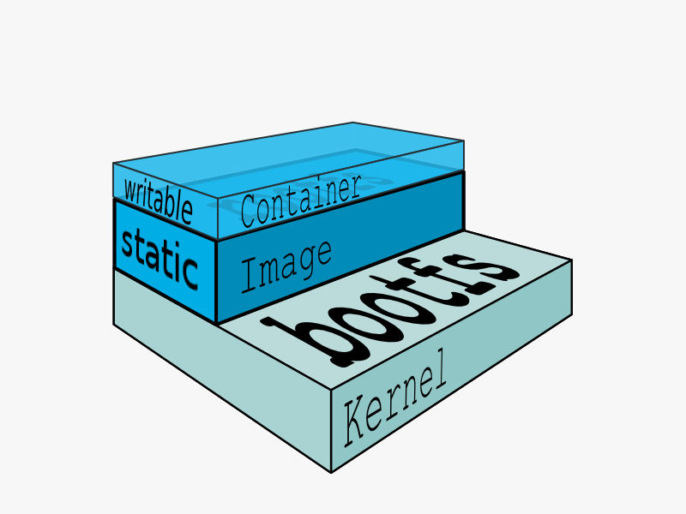
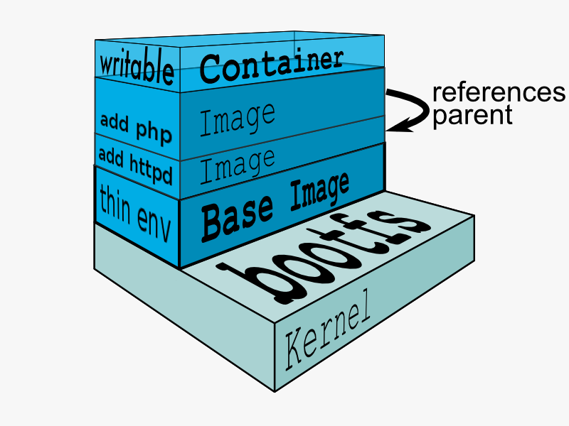
Glossary
Image
  Static
  Can be layered
Container
  Run processes
  Writable
  Layered on a particular image

Slide 8
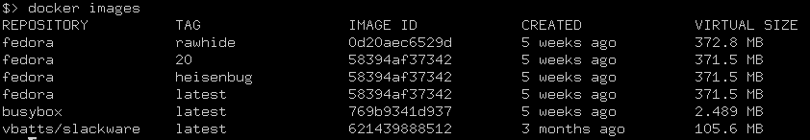
Docker 101
Hello, World!
$> docker run busybox echo “Hello, World!”
Fetch an Image
$> docker pull fedora
List Images
$> docker images

Slide 9
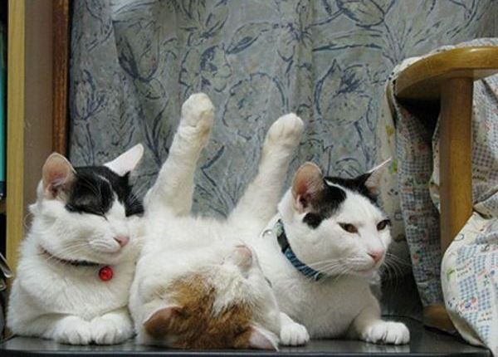
Consistency
development environment
Testing/QA environment
Production runtime

Slide 10
Dockerfile
Simple instructions
Feels like scripting
  FROM fedora
  RUN yum install -y mongodb-server && mkdir -p /data/db
  EXPOSE 27017
  VOLUME [“/data/db”]
  CMD “mongod”
Easy to make an image
  $> docker build -t my_mongo .

Slide 11
Demo!

Slide 12

Developer env
FROM fedora:20
RUN yum groupinstall -y “Development tools”
RUN yum install -y vim-enhanced git
RUN useradd -m -u 1000 -G wheel vbatts
USER vbatts
$> docker build -t my_dev:f20 .
Throw-away sandbox to hack inside!

Slide 13
CI / Testing
[...]
RUN cd /src/myapp && git pull --force origin master && \
autoreconf && \
./configure && \
make && \
make test
Test on a number of different environments
Failures in the docker build exit the build process

Slide 14
Quick Iteration
Share locally with a docker registry
  docker run -d -v /home/docker-registry:/var/lib/docker-registry \
  -p 5000:5000 vbatts/fedora-docker-registry
  docker tag my_dev this.host.lan:5000/vbatts/my_dev
  docker push this.host.lan:5000/vbatts/my_dev
Cached layers
  (extremely quick rebuilds for getting an image just right)
Tooling for incremental builds
  source-to-image

Slide 15
References
https://github.com/vbatts/laughing-octo/tree/master/fedora-docker-registry
https://github.com/pmorie/go-sti

